Slide 1
Tablue Project
File created on: 15/05/22 3:05:16 PM GMT+05:30

Slide 2
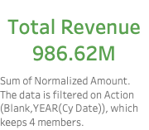

Slide 3
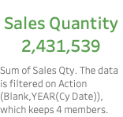

Slide 4
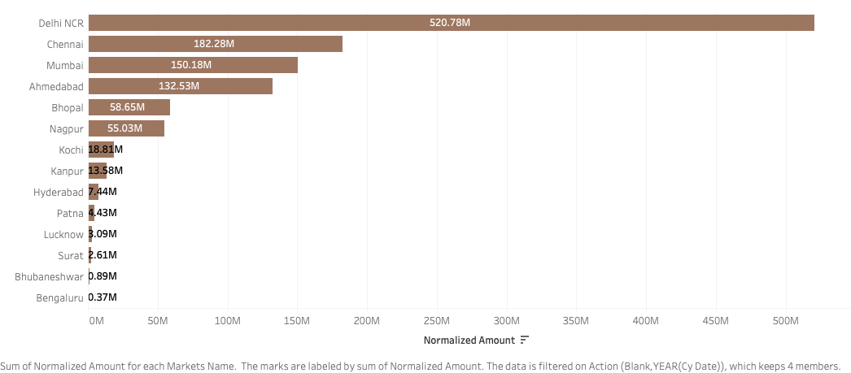

Slide 5
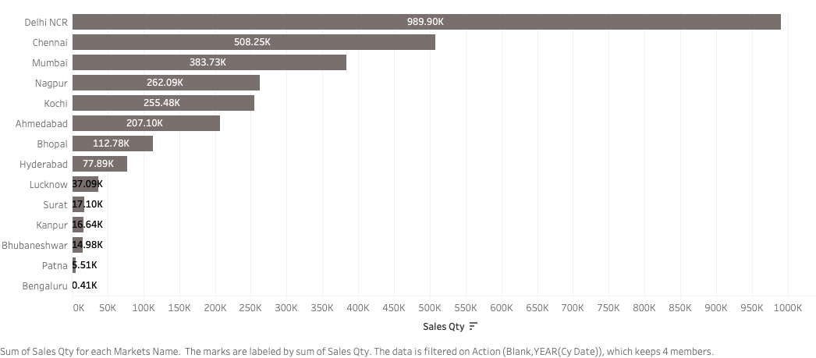

Slide 6


Slide 7


Slide 8
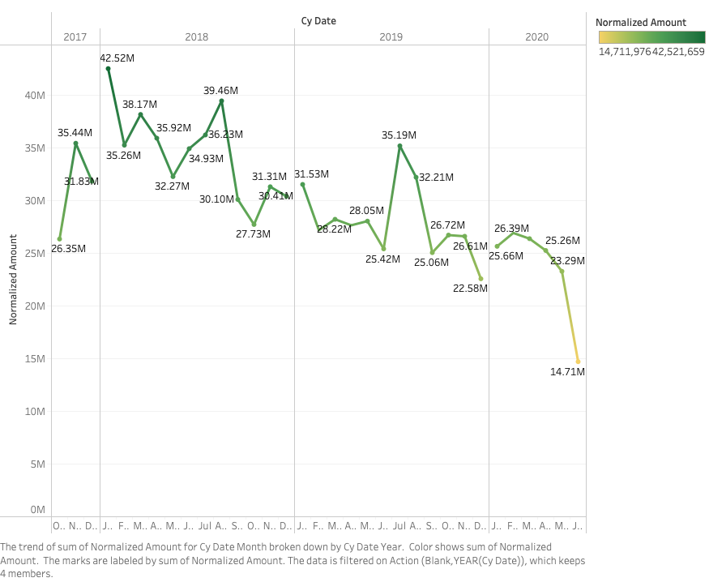

Slide 9


